Slide 1
Amazon Web Services
Cloud Engineering

Slide 2
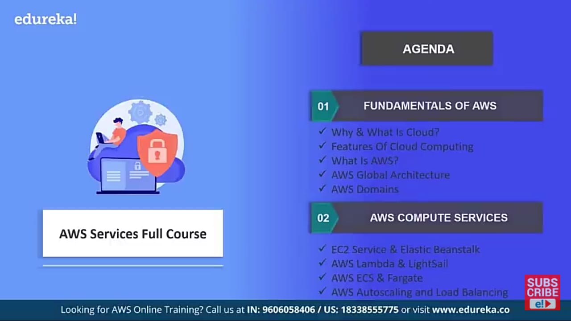
Session Contents

Slide 3
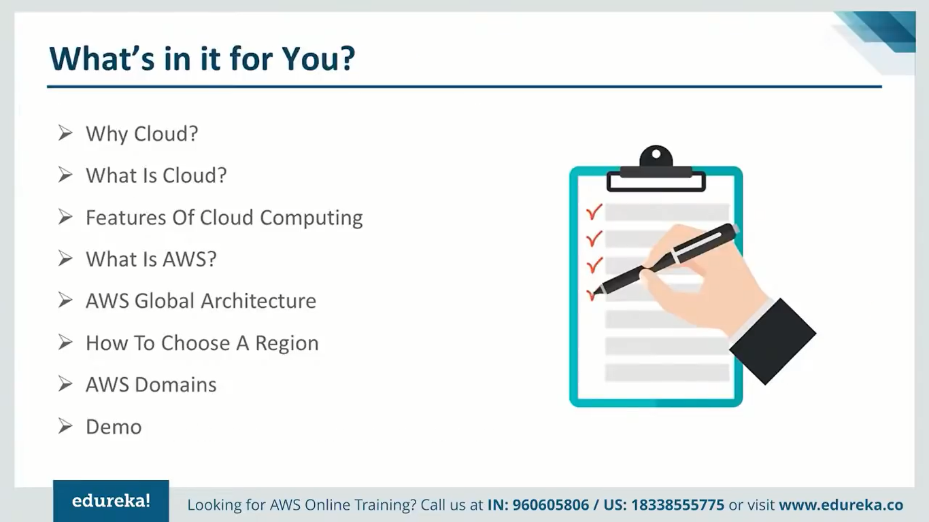
First Session

Slide 4
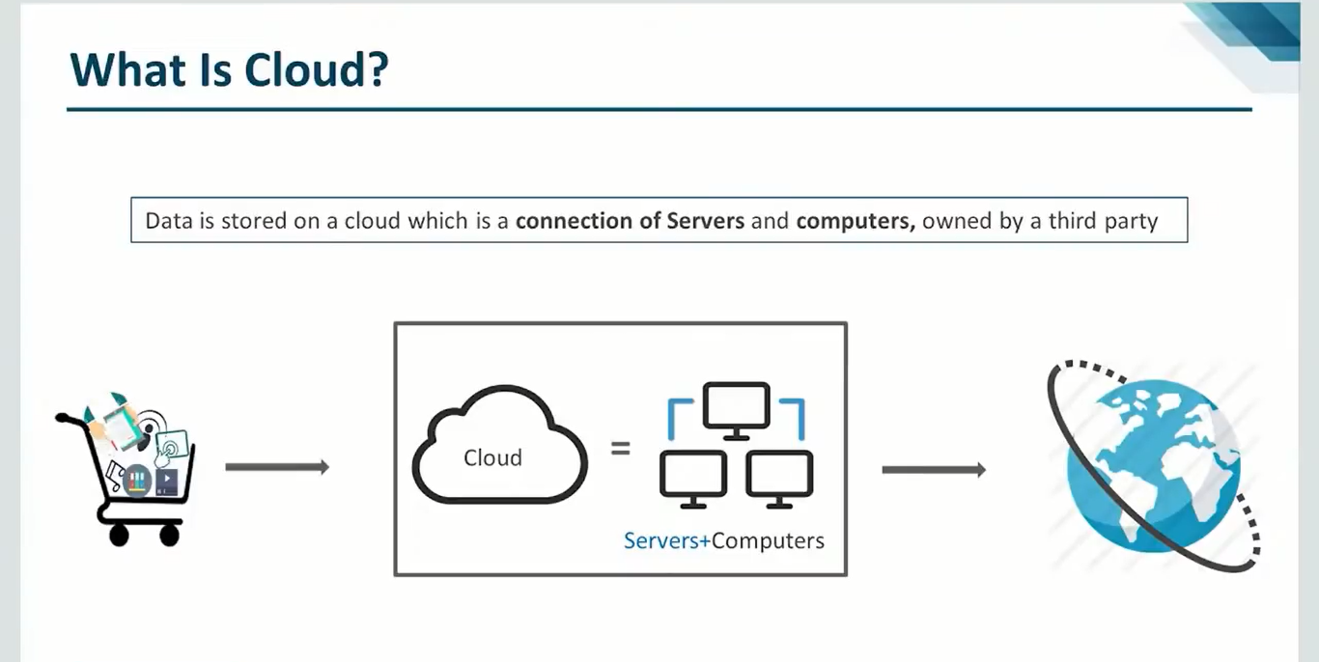
What

Slide 5
What is Cloud ?
Data Stores in cloud which is connection of server, computer, and owned by third party.

Slide 6
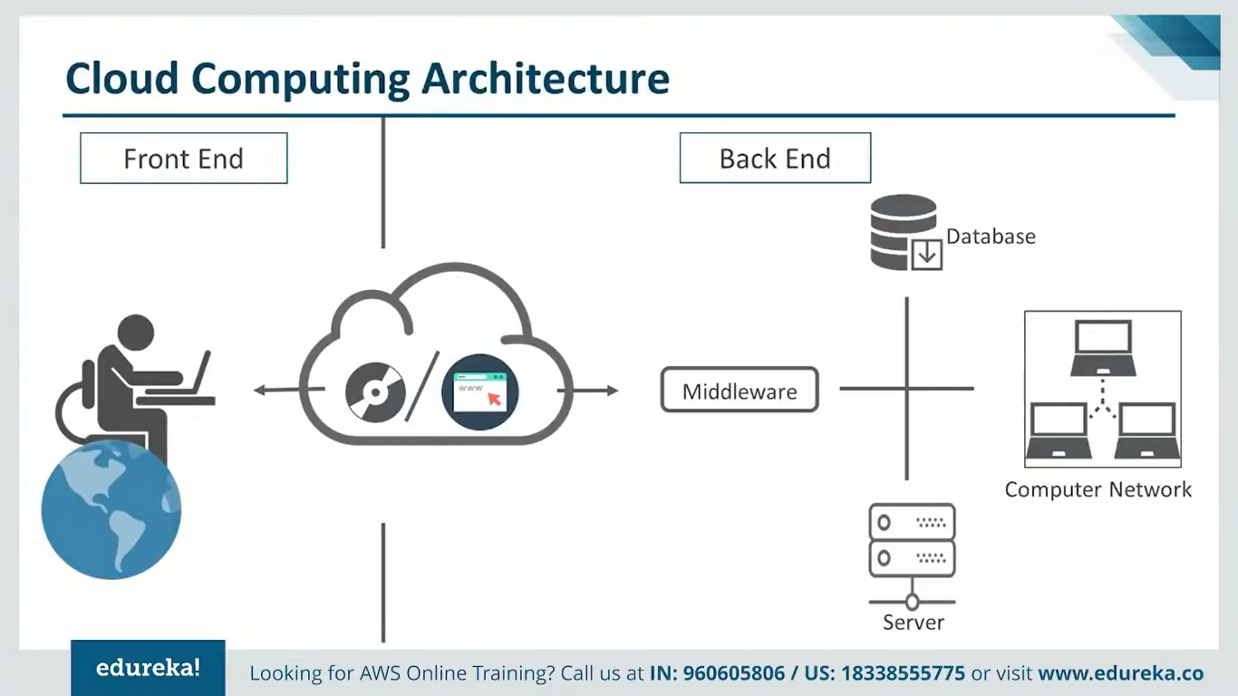

Slide 7
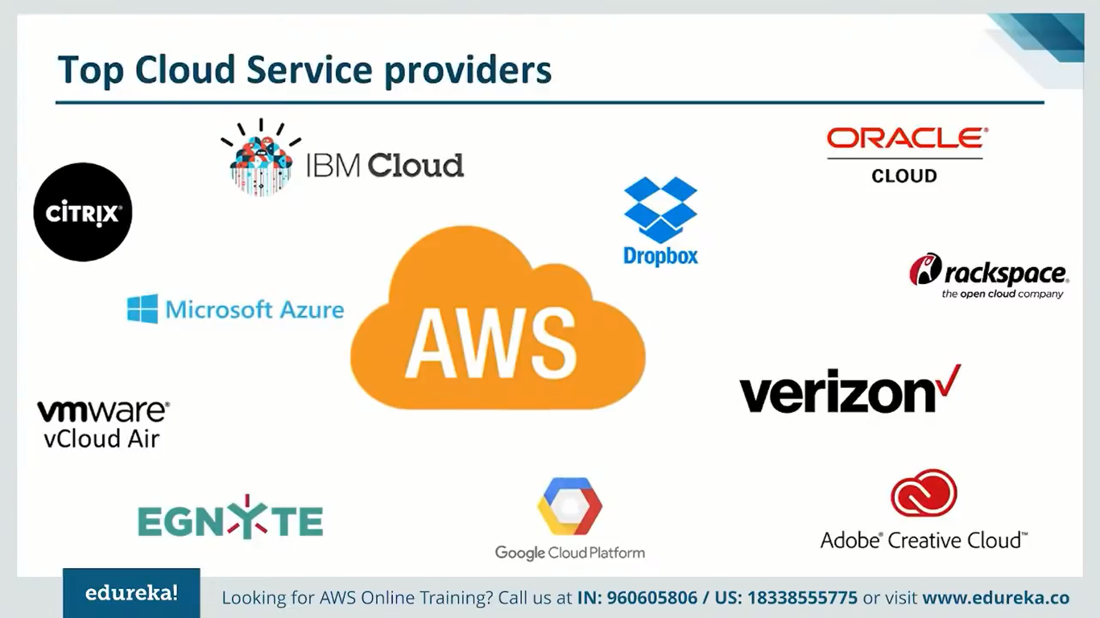

Slide 8

What is AWS

Slide 9
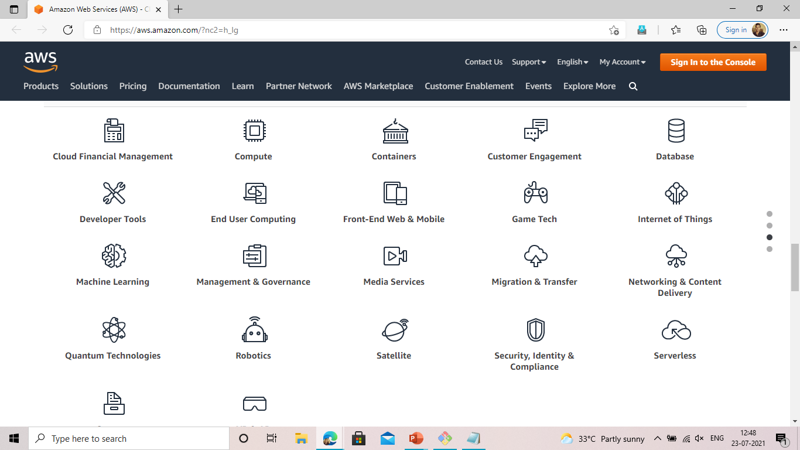
AWS Domains

Slide 10
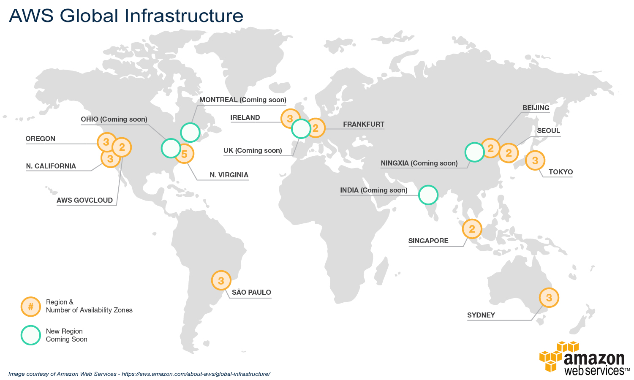
AWS Global Architecture

Slide 11
EC2

Slide 12
